Slide 1
HTTP
By:
Ganesh chHantyal(068/bct/520)
Nibesh Ranjit (068/BCT/539)

Slide 2
TOPICS COVERED
HTTP
HTTPS
HTTP vs HTTPS
CONNECTION in HTTP
OPERATION of HTTP

Slide 3
HTTP
Hyper Text Transport Protocol
An application level protocol for distributed, collaborative, hypermedia information systems
Uses PORT 80
Allows the transmitting and receiving of information across the Internet

Slide 4
HTTPS
Hyper Text Transfer Protocol ‘SECURE’
Secure hypertext transfer protocol
Uses PORT 443
One of the popular protocols to transfer sensitive data over the Internet
HTTPS is http using a Secure Socket Layer (SSL)
SSL is an encryption protocol invoked on a Web server that uses HTTPS
Implementations
online purchasing or the exchange of private information

Slide 5
HTTP vs HTTPS
HTTP is slightly faster than HTTP
HTTP is stateless
HTTPS is more secure than HTTP
Slows down web servers

Slide 6
CONNECTION in HTTP
Client initiate TCP connection to Server
Server accept TCP connection from Client
HTTP messages exchange between browser in client side and server side
TCP connection is disconnected

Slide 7
OPERATION of HTTP - HTTP protocol is a request-response protocol
CLIENT
SERVER
A client sends a request to the server in the form of
a request method
URI, and
protocol version
followed by a MIME (Multipurpose Internet Mail Extensions)-like message containing
request modifiers
client information, and
possible body content over a connection with a server
Responds with
a status line
the message’s protocol version and
a success or error code,
followed by a MIME-like message containing
server information,
entity meta information, and
possible entity-body content

Slide 8
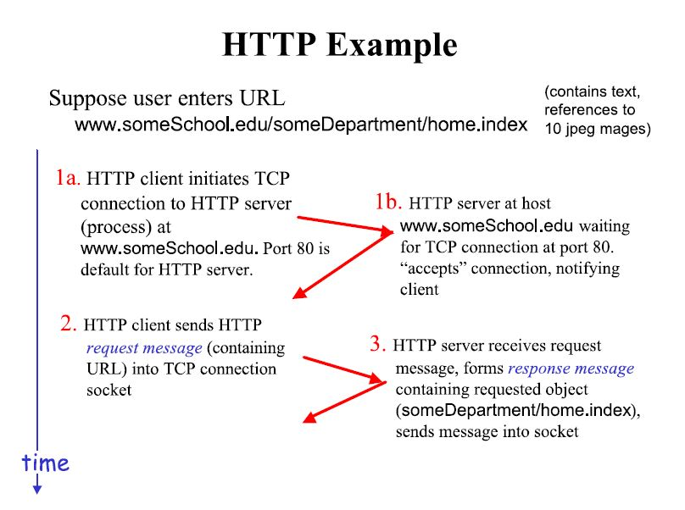

Slide 9
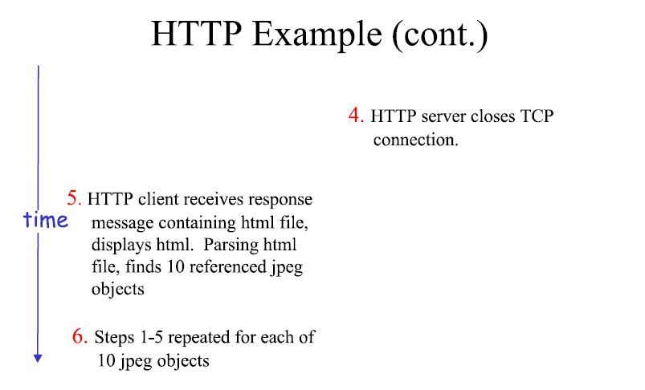

Slide 10
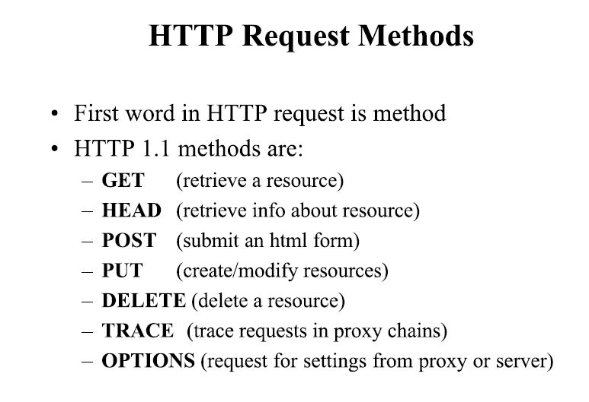

Slide 11
THANK YOU

